Slide 1
Beef and Nutrition

Slide 2
Terms
Calf – young animal, birth to about two years
Cow – mature female that has calved
Forage, roughage – grass, hay, or other fibrous, plant-based feed
Finishing – process of bringing a beef animal to market weight
Grain-fed – animal that is fed a diet including grains during finishing
Grass-fed – animal that is fed mostly forages during finishing

Slide 3
Nutrients in Beef

Slide 4
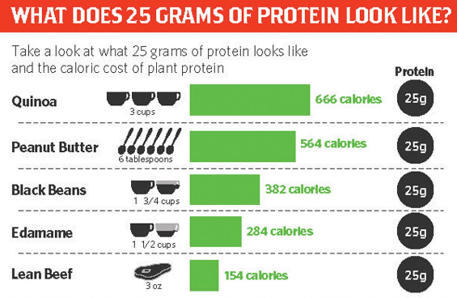
Protein
Important for muscle health, balanced diet, and feeling satisfied
25g of protein, about 50% daily value
Under 10% of daily calories
Beef protein is complete, meaning it contains all the amino acids needed for muscle development

Slide 5
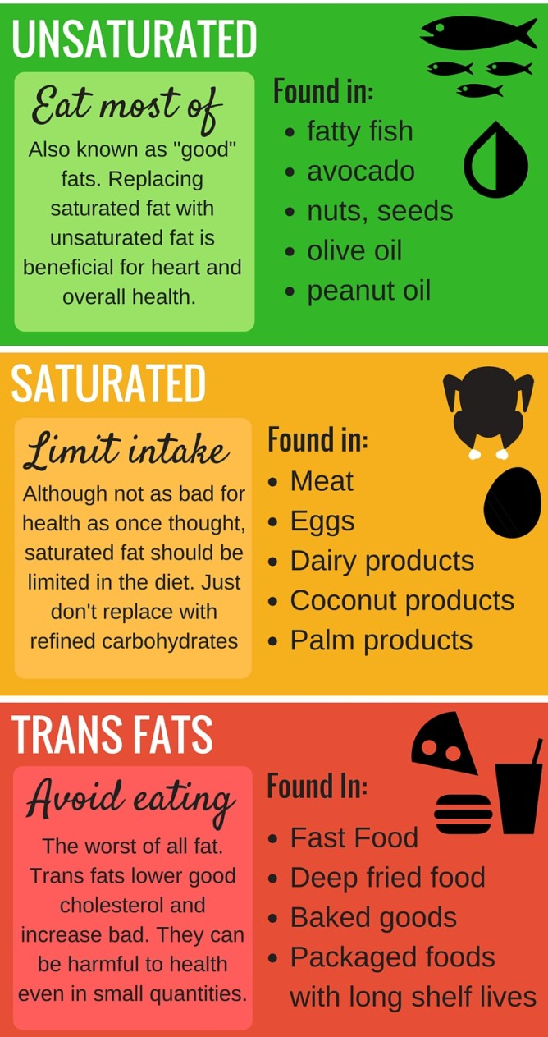
Fat
Research has shown that most natural fats are healthy for you.
Cholesterol: HDL (good) vs. LDL (bad)
Unsaturated fat is healthy for your heart and helps maintain healthy cholesterol levels
Saturated fat is healthy in moderation (less than 10% of daily calories)
Trans fat is bad for you and increases bad cholesterol
Notes:
Saturated fat
The molecules that make up a saturated fat source are completely “saturated” with hydrogen atoms. The reason most saturated fat-containing foods are solid at room temperature has to do with their molecular form. Oppositely, unsaturated fat is only partially saturated with hydrogen atoms. The difference in the placement of hydrogen atoms means the fats react very differently in your body.
Recent thinking on saturated fat has begun to change. When the burden of diet-related disease was thrown onto fat, saturated fat bore most of the brunt. Healthy eaters have been, and are still, advised to limit their intake of this type of fat because of a suspected link between saturated fat intake things like coronary heart disease, stroke and cardiovascular disease. meta-analysis from the American Journal of Clinical Nutrition evaluated the link between saturated fat and with cardiovascular disease.
Most evidence suggests that eating less saturated fat by increasing refined carbohydrates intake will NOT benefit health. Instead, your health will benefit most from replacing saturated fat intake with unsaturated fat, which will lower the nasty LDL cholesterol and provide more good HDL cholesterol
Unsaturated fat
In comparison to saturated fats, unsaturated fats are usually liquid at room temperature. They’re also considered to be beneficial for health. The key difference between the two is the amount of hydrogen atoms that “saturate” each molecule, causing them to act differently in the body.
Most people don’t eat enough of these healthy fats. Plenty of studies have found that increasingly unsaturated fat intake can have a whole bunch of positive health effects such as lowering the risk of heart disease, lowering bad cholesterol while increasing good cholesterol, lowering blood pressure and a lower risk of premature death in adults – especially if they’re consumed instead of saturated fats.

Slide 6
Fat
Fat in beef is…
Carcass Grades
Called “marbling”
Half saturated, half unsaturated
Affected by diet and genetics, the cut of meat, and processing
Marked on beef packages as a ratio of lean to fat (ex. 90/10)
USDA beef grades predict the juiciness and tastiness of meat, based on fat content.
Prime – young cattle, full marbling
Choice – high quality with less marbling
Select – leaner and less flavorful
Standard/Commercial – sold as “store brand”
Notes:
Prime – what you would get in a restauraunt

Slide 7
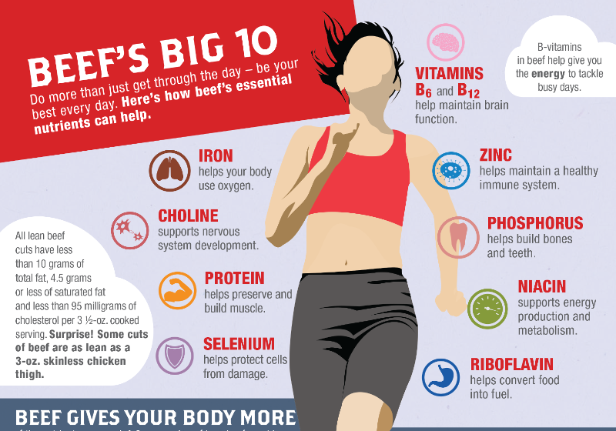
Other nutrients
Over 10% DV:
Iron
Phosphorus
Choline
Riboflavin
Over 20% DV:
B6 & B12
Zinc
Selenium
Niacin

Slide 8
Grain-fed vs. Grass-fed

Slide 9
Production differences
Calves live with mothers
Weaned at 8 months
Usually on pasture until about 1 year
Grain-fed:
Moved to a feed yard & fed an optimized diet
Harvested after 120-180 days
Grass-fed:
Continues to eat forages
Harvested when market weight (1-2 years later)

Slide 10
Feed differences
Grain-fed
Grass-fed
Corn
Silage
Distiller’s grains (protein)
Hay and forage
Free-choice, fed twice daily
Free access to water
Grass and other plants
Often supplemented with silage or hay, especially in winter
Free-choice
Free access to water

Slide 11
Nutritional differences
Sources conflict, but research studies have shown the following differences:
Grain-fed
Grass-fed
Higher oleic acid (a healthy unsaturated fat)
Lower saturated and trans fat
Slightly higher % omega-3s (healthy unsaturated fat)
Also higher % saturated and trans fat
Usually leaner than standard grain-fed
Nutrient content appears virtually the same between both types of meat with the same fat content.

Slide 12
Taste
Fat: More marbling = more juiciness, tenderness, and flavor. Grass-fed tends to be leaner and thus drier. There are also taste differences at the same fat content level.
Grain-fed
Grass-fed
Usually full marbling, juicier
Sweeter
Richer flavor
Usually leaner and drier
Mineral flavor
Gamier

Slide 13
conclusions

Slide 14
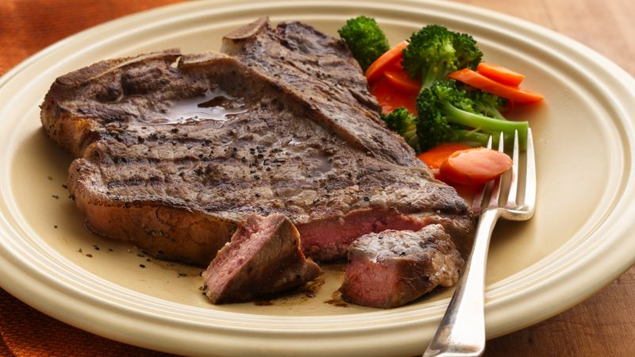
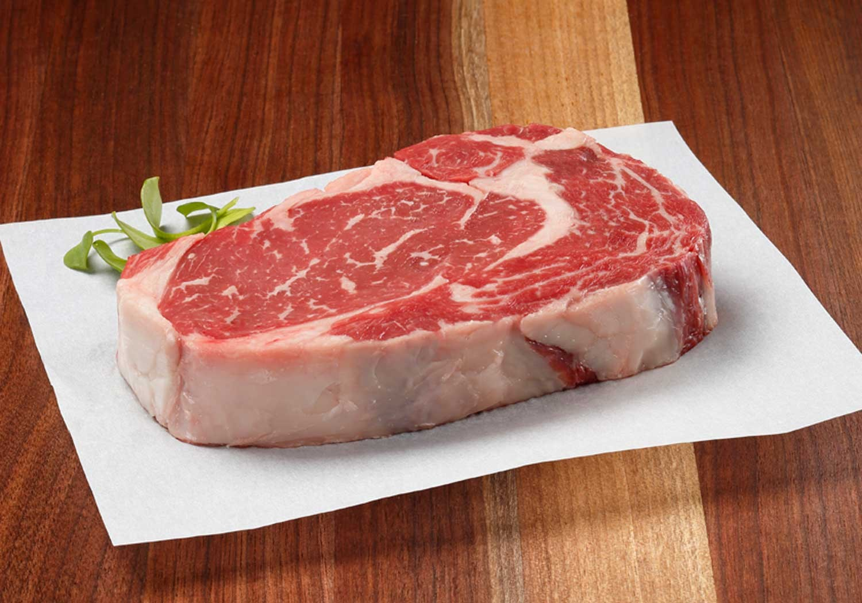
conclusions
Beef is a great source of important nutrients, especially protein
Beef fats are healthy in moderation
Grain-fed and grass-fed beef are similar in nutritional value

Slide 15
Questions?

Slide 16
sources
https://www.beefboard.org/pocket-guide/nutrition.html
https://www.beefitswhatsfordinner.com/nutrition/beef-nutrients
https://www.beefitswhatsfordinner.com/Media/BIWFD/Docs/proteins_are_not_created_equal.pdf
https://www.helpguide.org/articles/healthy-eating/choosing-healthy-fats.html
http://www.beefnutrition.org/CMDocs/BeefNutrition/Updated%20Materials/Beef%20and%20Health/BeefLipidsinPerspective.pdf
https://www.beefresearch.org/CMDocs/BeefResearch/Nutrition_Research_Brief/Impact%20of%20Grass%20-%20Forage%20Feeding%20Versus%20Grain%20Finishing%20on%20Beef%20Nutrients.pdf

